Slide 1
Block chain based crowdfunding platform
Submitted to,
Shammi Akhtar
Assistant Professor
Dept. of CSE, UAP
August 29, 2022

Slide 2
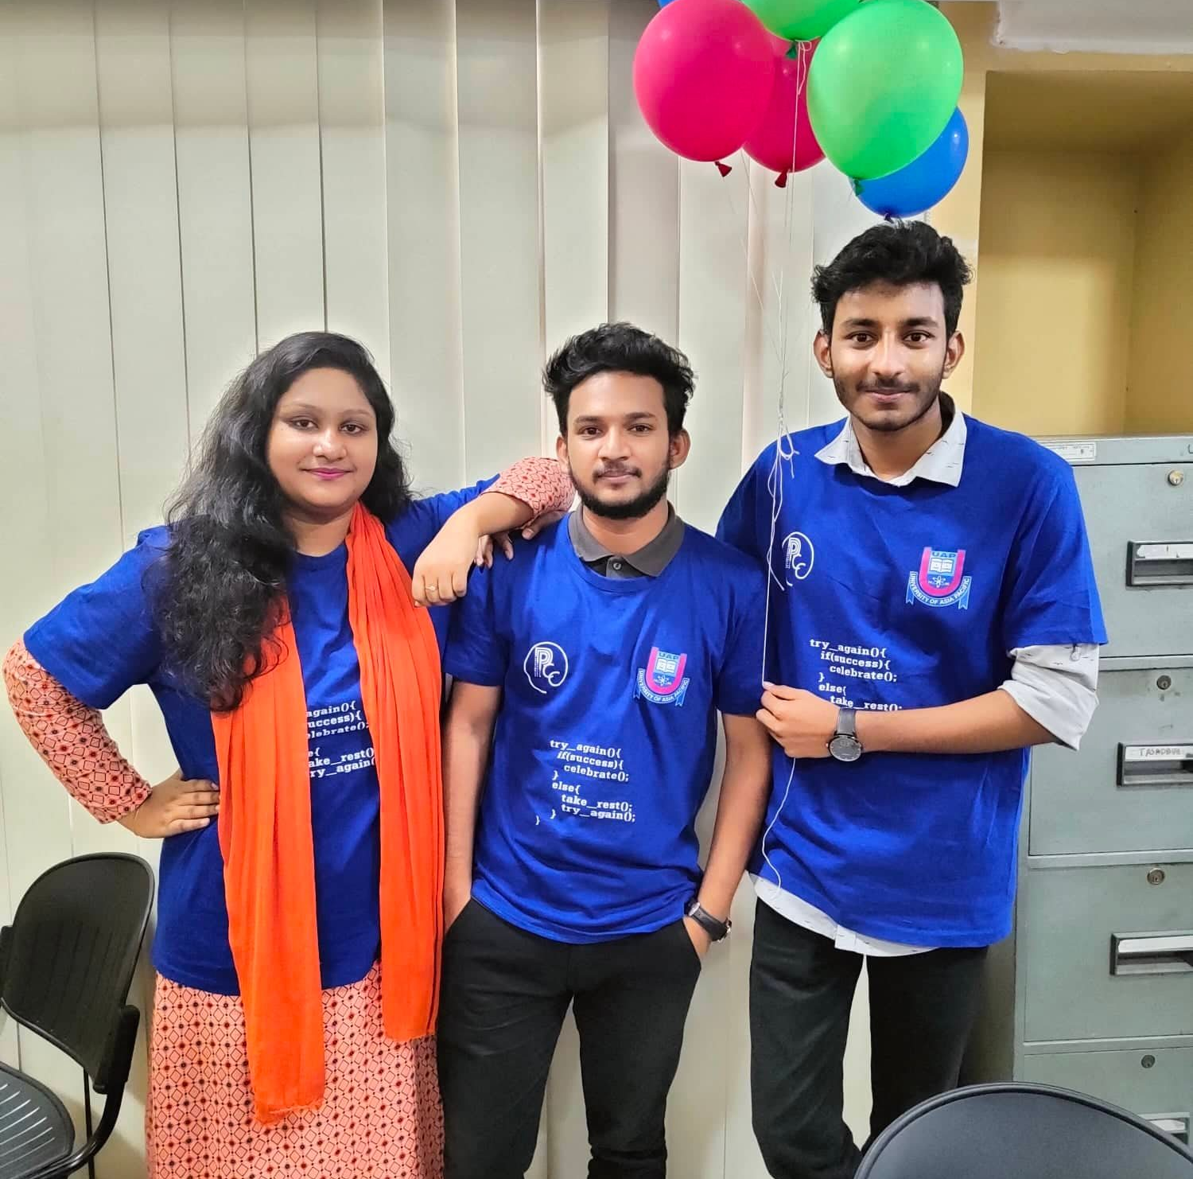
About Us
Bidita Sarkar Diba – 20101016
Md. Mahmudur Rahman - 20101009
Jayonto Dutta Plabon - 20101022

Slide 3
Fact finding methods
INTERVIEWS
QUESTIONNARIES
We conducted over 50+ interview Session with startup companies, organizations and End Users.
We gathered information with questionnaires method from 100+ companies, organizations and End users.
PROTOTYPING
JRP
We make a prototype and let the users to try our system. From that session we gathered some of the requirements.
We discussed about our plan with some professionals and check the feasibility of our system.

Slide 4
Software Requirements specifications
ADMIN
USER
Your Profile
Pending Projects
Approved Projects
Closed Project
Unapproved Project
Project wise Transaction List
Project wise investor list
Project wise User Details
Your Profile
Running Projects
Create Project
Pending Projects
Show Approved Projects
Show unapproved Projects
Project wise investor list
Transaction Details
i) Update Transaction
ii) Send transaction details to investors

Slide 5
Sequence of Activity
Activity No | Activity | Duration | Preceding Activity
A | Requirement Gathering | 3 Months | -----
B | Create Crypto | 2 Months | A
C | Create own Wallet | 2 Months | B
D | Design | 1 Month | A
E | Development | 4 Months | B,C,D
F | Testing | 1 Month | E
G | Advertising our System | 6 Months | F

Slide 6
Diagram
Create Crypto
Create own Wallet
3
5
C
5
7
B
2
3
5
2
5
7
Requirement Gathering
A
0
3
7
11
G
2
2
Start
E
End
3
0
3
4
7
11
2
2
2
Development
Advertising our System
D
3
4
F
2
2
1
6
7
2
2
2
Design
Testing

Slide 7
Forward, Backward Pass & Critical Path Calculation
Activity No | Activity | Duration | Preceding Activity | ES | EF | LS | LF | Slack | Critical Path or not
A | Requirement Gathering | 3 Months | ----- | 0 | 3 | 0 | 3 | 0 | Yes
B | Create Crypto | 2 Months | A | 3 | 5 | 3 | 5 | 0 | Yes
C | Create own Wallet | 2 Months | B | 5 | 7 | 5 | 7 | 0 | Yes
D | Design | 1 Month | A | 3 | 4 | 6 | 7 | 3 | No
E | Development | 4 Months | B,C,D | 7 | 11 | 7 | 11 | 0 | Yes
F | Testing | 1 Month | E | 11 | 12 | 11 | 12 | 0 | Yes
G | Advertising our System | 6 Months | F | 12 | 18 | 12 | 18 | 0 | Yes

Slide 8
Critical Path Diagram
Create own Wallet
3
5
C
5
7
B
2
3
5
2
5
7
Requirement Gathering
Create Crypto
A
0
3
7
11
G
2
2
Start
E
End
3
0
3
4
7
11
2
2
2
Development
Advertising our System
F
2
2
2
2
2
Testing

Slide 9
Thank you

